Slide 1
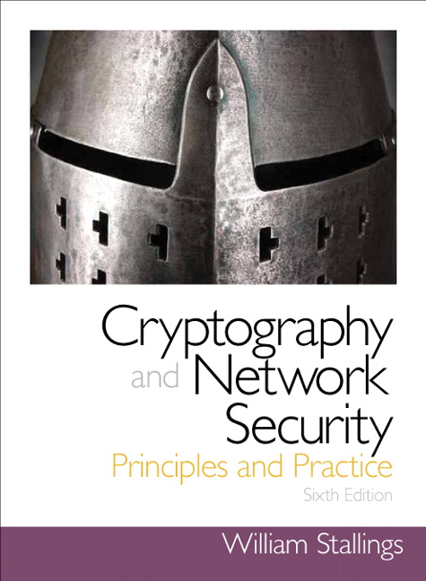
Cryptography and Network Security
Seventh Edition
by William Stallings
Notes:
Lecture slides prepared for “Cryptography and Network Security”, 6/e, by William Stallings, Chapter 12 – “Message Authentication Codes”.

Slide 2
Chapter 12
Message Authentication Codes
Notes:
This chapter begins with an introduction to the requirements for authentication
and digital signature and the types of attacks to be countered. Then the basic
approaches are surveyed. The remainder of the chapter deals with the fundamental
approach to message authentication known as the message authentication code
(MAC). Following an overview of this topic, the chapter looks at security considerations
for MACs. This is followed by a discussion of specific MACs in two categories:
those built from cryptographic hash functions and those built using a block cipher
mode of operation. Next, we look at a relatively recent approach known as authenticated
encryption. Finally, we look at the use of cryptographic hash functions and
MACs for pseudorandom number generation.

Slide 3
Announcement
Lab #1 report is due October 3rd before class begins
Class roster

Slide 4
Announcement
Extra credits!!!
October 18, 7:30am ~ 9:00am, ISACA breakfast in DSAC
October 23, Lewis Room, 7pm, Meet the Geeks
Nov 2: 3-5pm Spectrum is on campus for recruiting
Nov 6: 11-12, Internship boot camp event
If you attend three out of four and submit one page summary about three events on what you learned from them, you can get extra credits from my class.

Slide 5
Cyber News Sharing and Discussions
By Ryan
Who will be next to share on Tuesday?

Slide 6
Tentative Agenda
Sept. 26: Public-Key Crypto (Chapter 9)
Sept. 28: Message Authentication Code (Chapter 12)
October 3rd: Final course project kick-off presentation
11 groups: each group 5 minutes+1 minute Q&A
October 5th: Network access control and cloud security
(Chapter 16th)
October 10th: Transport layer security (Chapter 17)
October 12th: midterm exam review
October 17th: Fall break. No class
October 19th: midterm exam
October 24th: midterm mandatory group meetings

Slide 7
Final Course Project Kick-Off Presentations
Each group have 5 minutes presentation + 1 minute Q&A
Please prepare 5~6 slides and each group member should present 1~2 slides.
Example of contents:
Final course project topic description
Goals that your group want to achieve
Group member introduction
Task assignment
Timeline
Reference/resources

Slide 8
Message Authentication Functions or Algorithms
Hash function
A function that maps a message of any length into a fixed-length hash value which serves as the authenticator
Message encryption
The ciphertext of the entire message serves as its authenticator
Message authentication code (MAC)
A function of the message and a secret key that produces a fixed-length value that serves as the authenticator
Notes:
Any message authentication or digital signature mechanism has two levels of functionality.
At the lower level, there must be some sort of function that produces
an authenticator: a value to be used to authenticate a message. This lower-level
function is then used as a primitive in a higher-level authentication protocol that
enables a receiver to verify the authenticity of a message.
This section is concerned with the types of functions that may be used to produce
an authenticator. These may be grouped into three classes.
• Hash function: A function that maps a message of any length into a fixed-length
hash value, which serves as the authenticator
• Message encryption: The ciphertext of the entire message serves as its
authenticator
• Message authentication code (MAC): A function of the message and a secret
key that produces a fixed-length value that serves as the authenticator
Hash functions, and how they may serve for message authentication, are discussed
in Chapter 11. The remainder of this section briefly examines the remaining
two topics. The remainder of the chapter elaborates on the topic of MACs.

Slide 9
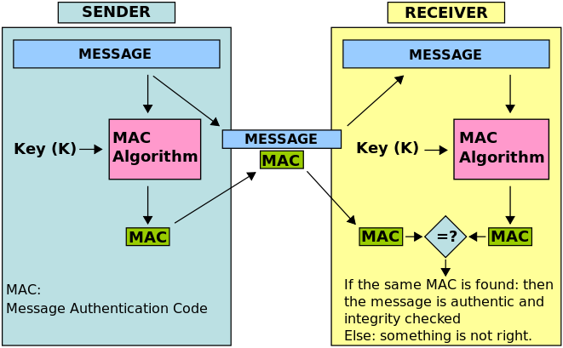
Message Authentication Code

Slide 10
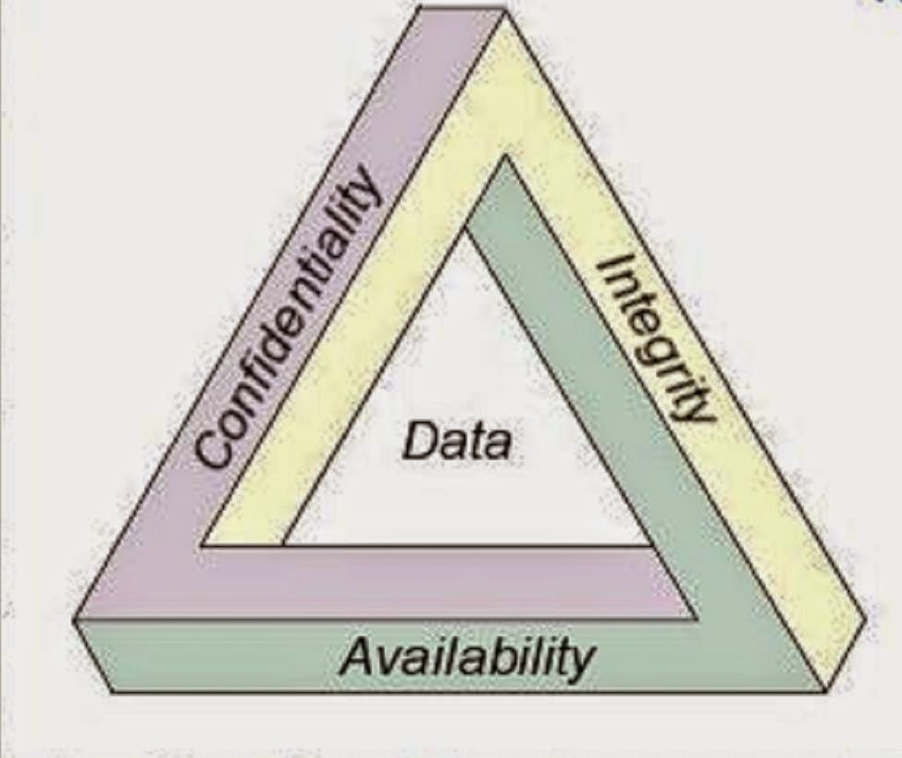
CIA Triad

Slide 11
Questions
MAC has other meanings in computer networking?
Among confidentiality, integrity, and availability, which one message authentication code is protecting?

Slide 12
Brute-Force Attack
Requires known message-tag pairs
A brute-force method of finding a collision is to pick a random bit string y and check if H(y) = H(x)
Two lines of attack:
Attack the key space
If an attacker can determine the MAC key then it is possible to generate a valid MAC value for any input x
Attack the MAC value
Objective is to generate a valid tag for a given message or to find a message that matches a given tag
Notes:
A brute-force attack on a MAC is a more difficult undertaking than a brute-force
attack on a hash function because it requires known message-tag pairs. Let us see
why this is so. To attack a hash code, we can proceed in the following way. Given
a fixed message x with n -bit hash code h = H(x ), a brute-force method of finding
a collision is to pick a random bit string y and check if H(y ) = H(x ). The attacker
can do this repeatedly off line. Whether an off-line attack can be used on a MAC
algorithm depends on the relative size of the key and the tag.
The attacker would like to come up with the valid MAC code for a
given message x . There are two lines of attack possible: attack the key space and
attack the MAC value. We examine each of these in turn.
If an attacker can determine the MAC key, then it is possible to generate a
valid MAC value for any input x . Suppose the key size is k bits and that the attacker
has one known text-tag pair. Then the attacker can compute the n -bit tag on the
known text for all possible keys. At least one key is guaranteed to produce the correct
tag, namely, the valid key that was initially used to produce the known text-tag
pair. This phase of the attack takes a level of effort proportional to 2^{k} (that is, one
operation for each of the 2^{k} possible key values). However, as was described earlier,
because the MAC is a many-to-one mapping, there may be other keys that produce
the correct value. Thus, if more than one key is found to produce the correct value,
additional text-tag pairs must be tested. It can be shown that the level of effort
drops off rapidly with each additional text-MAC pair and that the overall level of
effort is roughly 2^{k} [MENE97].
An attacker can also work on the tag without attempting to recover the key.
Here, the objective is to generate a valid tag for a given message or to find a message
that matches a given tag. In either case, the level of effort is comparable to that for
attacking the one-way or weak collision-resistant property of a hash code, or 2^{n} . In
the case of the MAC, the attack cannot be conducted off line without further input;
the attacker will require chosen text-tag pairs or knowledge of the key.
To summarize, the level of effort for brute-force attack on a MAC algorithm
can be expressed as min(2^{k} , 2^{n} ). The assessment of strength is similar to that for
symmetric encryption algorithms. It would appear reasonable to require that the
key length and tag length satisfy a relationship such as min(k , n) ≥ N , where N is
perhaps in the range of 128 bits.

Slide 13
Cryptanalysis
Cryptanalytic attacks seek to exploit some property of the algorithm to perform some attack other than an exhaustive search
An ideal MAC algorithm will require a cryptanalytic effort greater than or equal to the brute-force effort
There is much more variety in the structure of MACs than in hash functions, so it is difficult to generalize about the cryptanalysis of MACs
Notes:
As with encryption algorithms and hash functions, cryptanalytic attacks on MAC
algorithms seek to exploit some property of the algorithm to perform some attack
other than an exhaustive search. The way to measure the resistance of a MAC algorithm
to cryptanalysis is to compare its strength to the effort required for a brute-force
attack. That is, an ideal MAC algorithm will require a cryptanalytic effort
greater than or equal to the brute-force effort.
There is much more variety in the structure of MACs than in hash functions,
so it is difficult to generalize about the cryptanalysis of MACs. Furthermore, far less
work has been done on developing such attacks. A useful survey of some methods
for specific MACs is [PREN96].

Slide 14
MACs Based on Hash Functions: HMAC
There has been increased interest in developing a MAC derived from a cryptographic hash function
Motivations:
Cryptographic hash functions such as MD5 and SHA generally execute faster in software than symmetric block ciphers such as DES
Library code for cryptographic hash functions is widely available
HMAC has been chosen as the mandatory-to-implement MAC for IP security
Has also been issued as a NIST standard (FIPS 198)
Notes:
Later in this chapter, we look at examples of a MAC based on the use of a symmetric
block cipher. This has traditionally been the most common approach to
constructing a MAC. In recent years, there has been increased interest in developing
a MAC derived from a cryptographic hash function. The motivations for this
interest are
1. Cryptographic hash functions such as MD5 and SHA generally execute faster
in software than symmetric block ciphers such as DES.
2. Library code for cryptographic hash functions is widely available.
With the development of AES and the more widespread availability of code
for encryption algorithms, these considerations are less significant, but hash-based
MACs continue to be widely used.
A hash function such as SHA was not designed for use as a MAC and cannot
be used directly for that purpose, because it does not rely on a secret key.
There have been a number of proposals for the incorporation of a secret key into
an existing hash algorithm. The approach that has received the most support is
HMAC [BELL96a, BELL96b]. HMAC has been issued as RFC 2104, has been
chosen as the mandatory-to-implement MAC for IP security, and is used in other
Internet protocols, such as SSL. HMAC has also been issued as a NIST standard
(FIPS 198).

Slide 15
HMAC Design Objectives
RFC 2104 lists the following objectives for HMAC:
To use, without modifications, available hash functions
To allow for easy replaceability of the embedded hash function in case faster or more secure hash functions are found or required
To preserve the original performance of the hash function without incurring a significant degradation
To use and handle keys in a simple way
To have a well understood cryptographic analysis of the strength of the authentication mechanism based on reasonable assumptions about the embedded hash function
Notes:
RFC 2104 lists the following design objectives for HMAC:
• To use, without modifications, available hash functions. In particular, hash functions that perform well in software, and for which code is freely and widely available.
• To allow for easy replaceability of the embedded hash function in case faster or more secure hash functions are found or required.
• To preserve the original performance of the hash function without incurring a significant degradation.
• To use and handle keys in a simple way.
• To have a well understood cryptographic analysis of the strength of the authentication mechanism based on reasonable assumptions about the embedded hash function.
The first two objectives are important to the acceptability of HMAC. HMAC
treats the hash function as a “black box.” This has two benefits. First, an existing
implementation of a hash function can be used as a module in implementing HMAC.
In this way, the bulk of the HMAC code is prepackaged and ready to use without
modification. Second, if it is ever desired to replace a given hash function in an
HMAC implementation, all that is required is to remove the existing hash function
module and drop in the new module. This could be done if a faster hash function were
desired. More important, if the security of the embedded hash function were compromised,
the security of HMAC could be retained simply by replacing the embedded
hash function with a more secure one (e.g., replacing SHA- 2 with SHA-3).
The last design objective in the preceding list is, in fact, the main advantage
of HMAC over other proposed hash-based schemes. HMAC can be proven secure
provided that the embedded hash function has some reasonable cryptographic
strengths. We return to this point later in this section, but first we examine the structure
of HMAC.

Slide 16
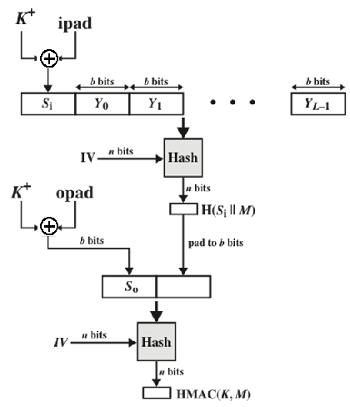
HMAC Structure
Notes:
Figure 12.5 illustrates the overall operation of HMAC.

Slide 17
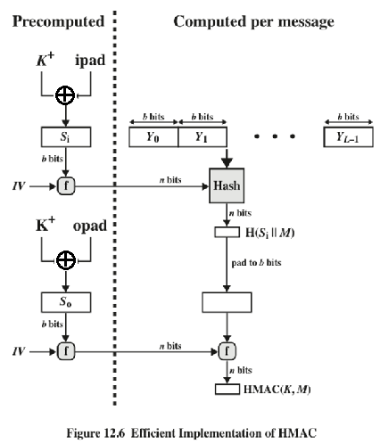
Notes:
A more efficient implementation is possible, as shown in Figure 12.6.

Slide 18
Exercise of HMAC
Notes:
The security of any MAC function based on an embedded hash function depends
in some way on the cryptographic strength of the underlying hash function. The
appeal of HMAC is that its designers have been able to prove an exact relationship
between the strength of the embedded hash function and the strength
of HMAC.
The security of a MAC function is generally expressed in terms of the probability
of successful forgery with a given amount of time spent by the forger and
a given number of message-tag pairs created with the same key. In essence, it is
proved in [BELL96a] that for a given level of effort (time, message–tag pairs) on
messages generated by a legitimate user and seen by the attacker, the probability
of successful attack on HMAC is equivalent to one of the following attacks on the
embedded hash function.
1. The attacker is able to compute an output of the compression function even
with an IV that is random, secret, and unknown to the attacker.
2. The attacker finds collisions in the hash function even when the IV is random
and secret.

Slide 19
Security of HMAC
Depends in some way on the cryptographic strength of the underlying hash function
Appeal of HMAC is that its designers have been able to prove an exact relationship between the strength of the embedded hash function and the strength of HMAC
Generally expressed in terms of the probability of successful forgery with a given amount of time spent by the forger and a given number of message-tag pairs created with the same key
Notes:
The security of any MAC function based on an embedded hash function depends
in some way on the cryptographic strength of the underlying hash function. The
appeal of HMAC is that its designers have been able to prove an exact relationship
between the strength of the embedded hash function and the strength
of HMAC.
The security of a MAC function is generally expressed in terms of the probability
of successful forgery with a given amount of time spent by the forger and
a given number of message-tag pairs created with the same key. In essence, it is
proved in [BELL96a] that for a given level of effort (time, message–tag pairs) on
messages generated by a legitimate user and seen by the attacker, the probability
of successful attack on HMAC is equivalent to one of the following attacks on the
embedded hash function.
1. The attacker is able to compute an output of the compression function even
with an IV that is random, secret, and unknown to the attacker.
2. The attacker finds collisions in the hash function even when the IV is random
and secret.

Slide 20
CBC-MAC
In cryptography, a cipher block chaining message authentication code (CBC-MAC) is a technique for constructing a message authentication code from a block cipher.

Slide 21
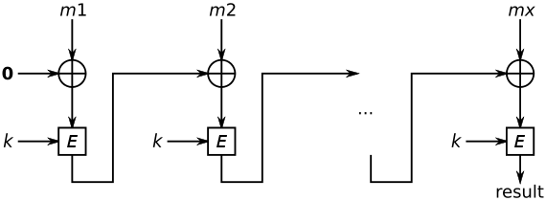
CBC-MAC

Slide 22

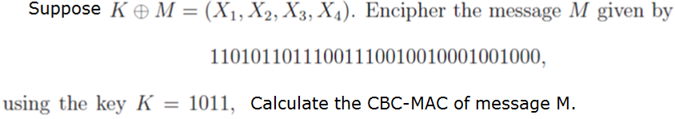
Exercise of CBC-MAC

Slide 23
Summary
What is message authentication code?
Security of MACs
Brute-force attacks
Cryptanalysis
MACs based on hash functions: (HMAC)
HMAC design objectives
HMAC algorithm
Security of HMAC
Introduction to CBC-MAC
Notes:
Chapter 12 summary.

Slide 24
Any Questions?

